Slide 1
INST 414: Data Science Techniques Lecture 2b Joint Probability Distributions

Slide 2
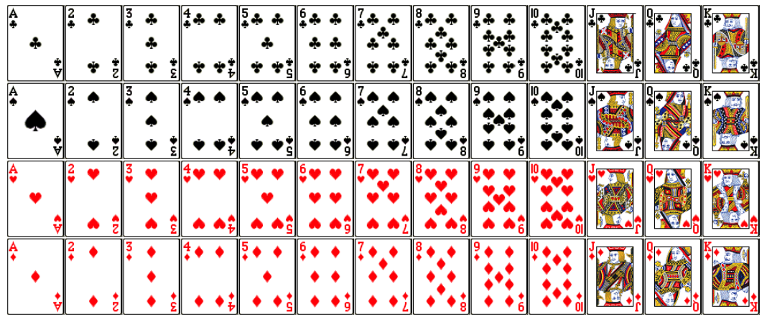
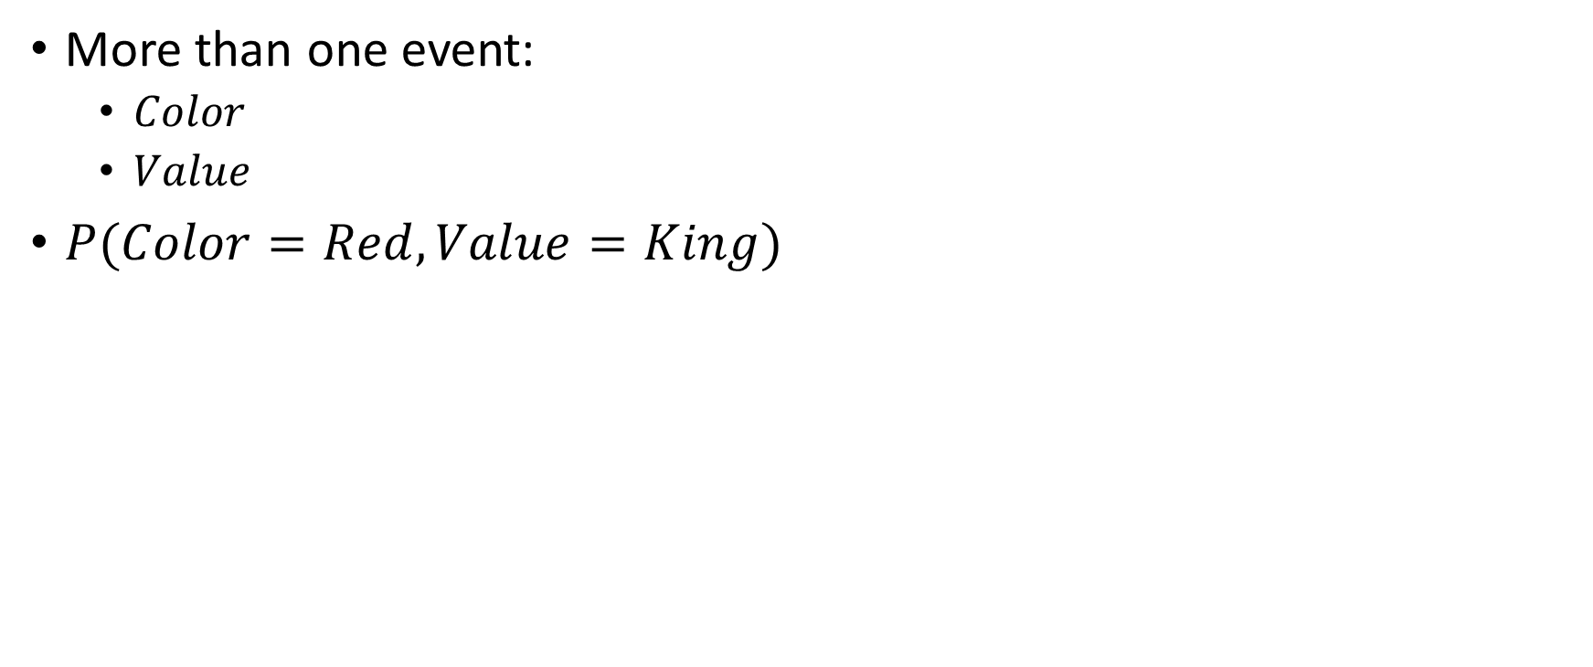
Event Space
More than one event:
$Color$
$Value$
$P(Color=Red, Value=King)$

Slide 3
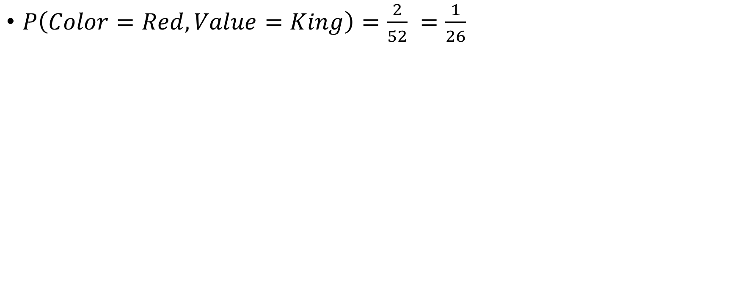
Event Space for Two Random Variables
$P\left(Color=Red, Value=King\right)=\frac{2}{52} =\frac{1}{26}$

Slide 4
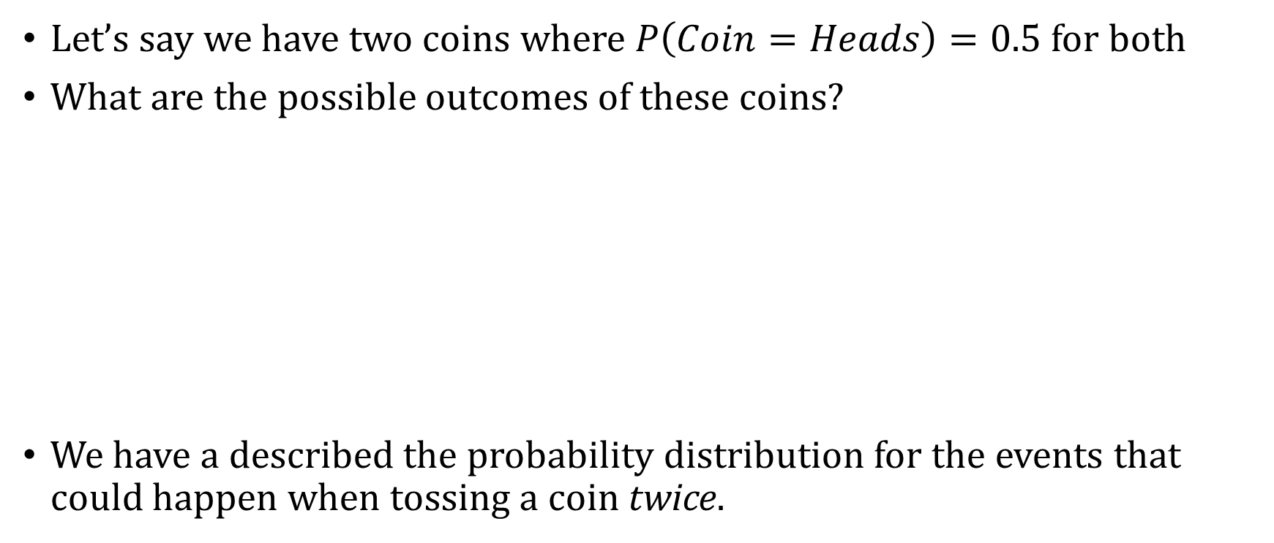
Two Random Variables
Let’s say we have two coins where $P\left(Coin=Heads\right)=0.5$ for both
What are the possible outcomes of these coins?
We have a described the probability distribution for the events that could happen when tossing a coin twice.
Coin 1 | Coin 2 | P(Coin 1=c, Coin 2=c)
Heads | Heads | 0.25
Heads | Tails | 0.25
Tails | Heads | 0.25
Tails | Tails | 0.25

Slide 5
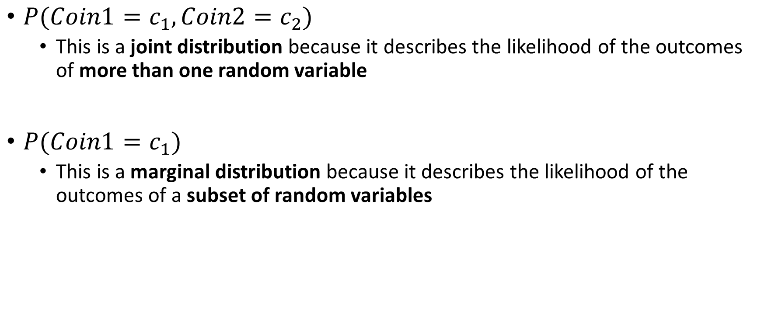
Marginal and Joint Distributions
$P(Coin1=c_{1}, Coin2=c_{2})$
This is a joint distribution because it describes the likelihood of the outcomes of more than one random variable
$P(Coin1=c_{1})$
This is a marginal distribution because it describes the likelihood of the outcomes of a subset of random variables

Slide 6

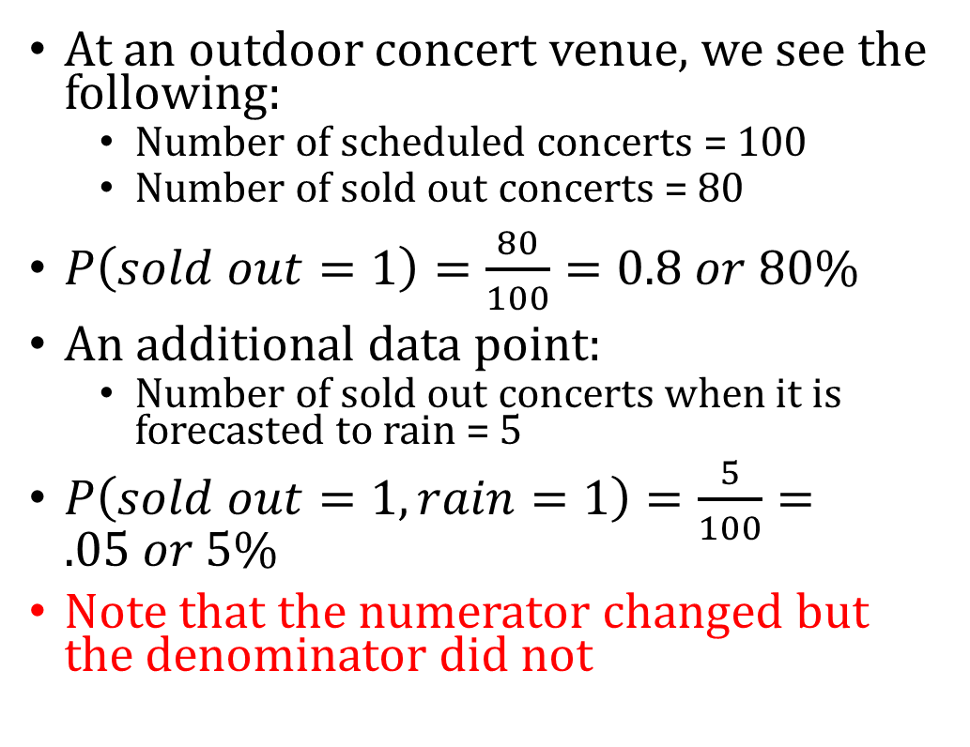
Interpreting Joint Distributions
At an outdoor concert venue, we see the following:
Number of scheduled concerts = 100
Number of sold out concerts = 80
$P\left(sold out=1\right)=\frac{80}{100}=0.8 or 80\%$
An additional data point:
Number of sold out concerts when it is forecasted to rain = 5
$P\left(sold out=1, rain=1\right)=\frac{5}{100}=.05 or 5\%$
Note that the numerator changed but the denominator did not

Slide 7
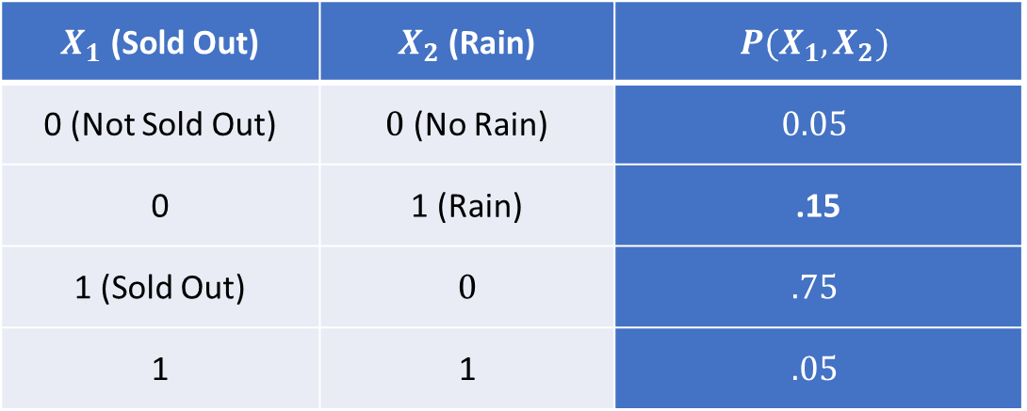
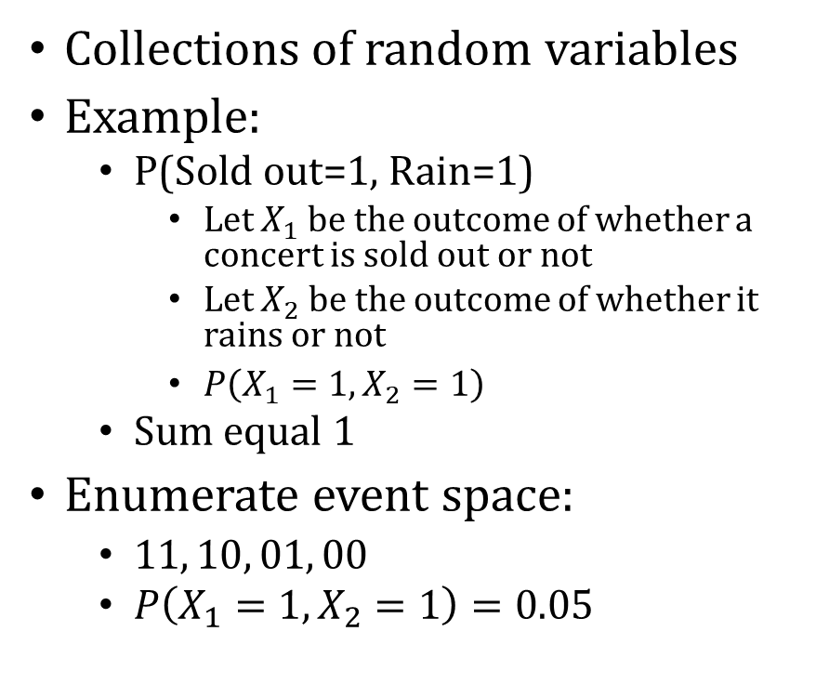
Joint Distribution
Collections of random variables
Example:
P(Sold out=1, Rain=1)
Let $X_{1}$ be the outcome of whether a concert is sold out or not
Let $X_{2}$ be the outcome of whether it rains or not
$P\left(X_{1}=1, X_{2}=1\right)$
Sum equal 1
Enumerate event space:
$11, 10, 01, 00$
$P\left(X_{1}=1, X_{2}=1\right)=0.05$
$X_{1}$ (Sold Out) | $X_{2}$ (Rain) | $$P(X_{1},X_{2})$$
0 (Not Sold Out) | $0$ (No Rain) | $$0.05$$
0 | 1 (Rain) | .15
1 (Sold Out) | $$0$$ | $$.75$$
1 | 1 | $$.05$$

Slide 8
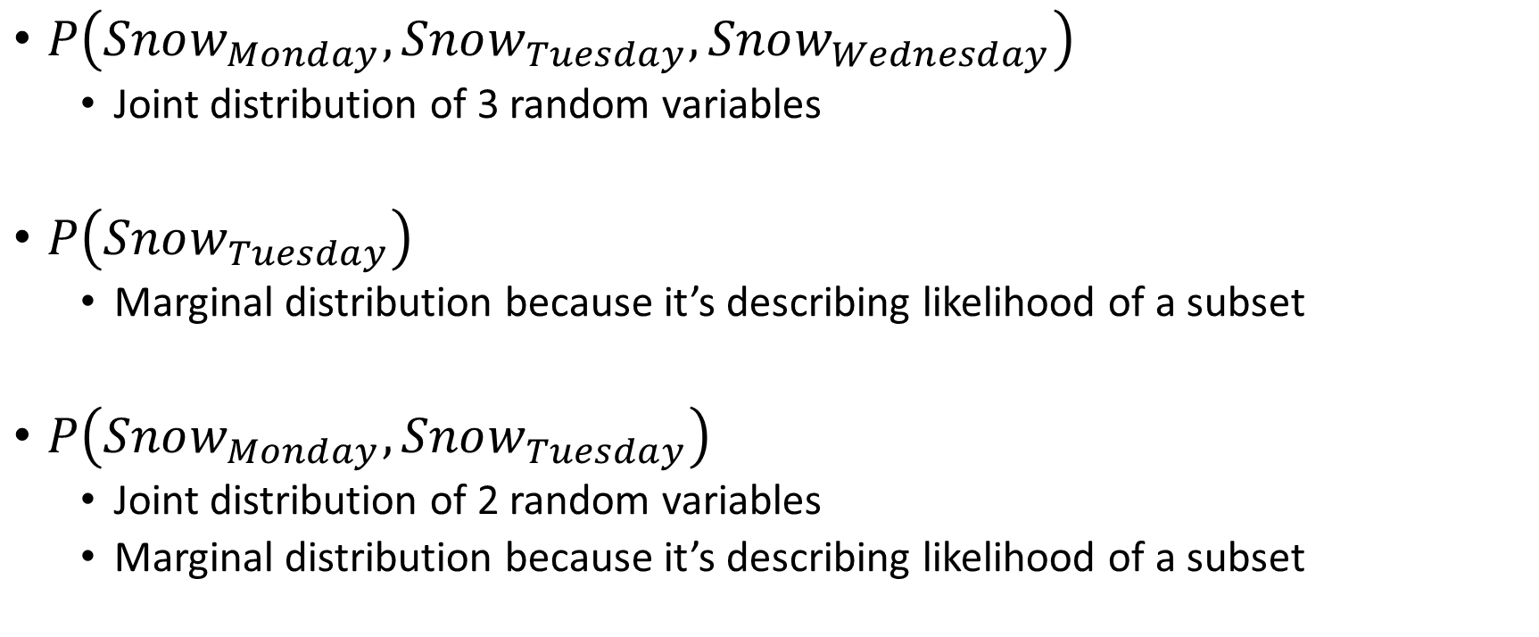
Examples
$P\left(Snow_{Monday},Snow_{Tuesday}, Snow_{Wednesday}\right)$
Joint distribution of 3 random variables
$P\left(Snow_{Tuesday}\right)$
Marginal distribution because it’s describing likelihood of a subset
$P\left(Snow_{Monday}, Snow_{Tuesday}\right)$
Joint distribution of 2 random variables
Marginal distribution because it’s describing likelihood of a subset

Slide 9
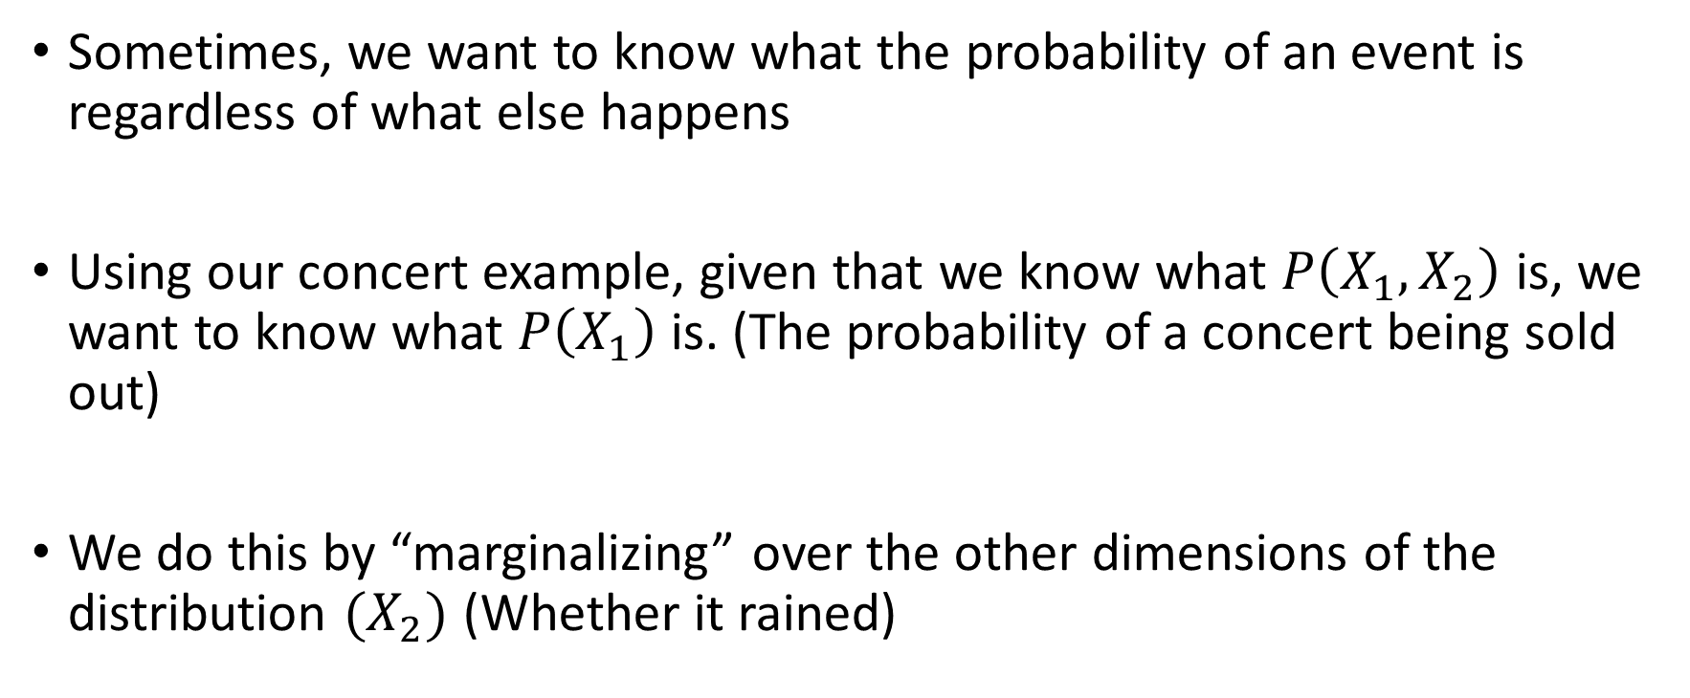
Going from Joint to Marginal Distribution
Sometimes, we want to know what the probability of an event is regardless of what else happens
Using our concert example, given that we know what $P\left(X_{1},X_{2}\right)$ is, we want to know what $P\left(X_{1}\right)$is. (The probability of a concert being sold out)
We do this by “marginalizing” over the other dimensions of the distribution $(X_{2})$ (Whether it rained)

Slide 10
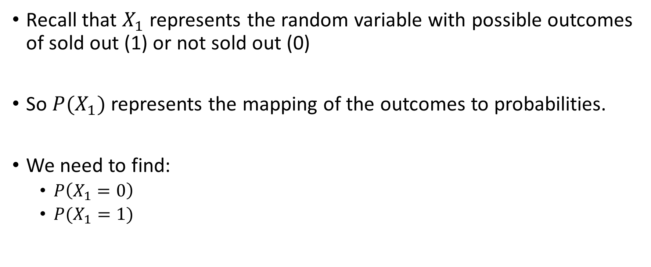

What is $P\left(X_{1}\right)?$
Recall that $X_{1}$ represents the random variable with possible outcomes of sold out (1) or not sold out (0)
So $P(X_{1})$ represents the mapping of the outcomes to probabilities.
We need to find:
$P\left(X_{1}=0\right)$
$P(X_{1}=1)$

Slide 11
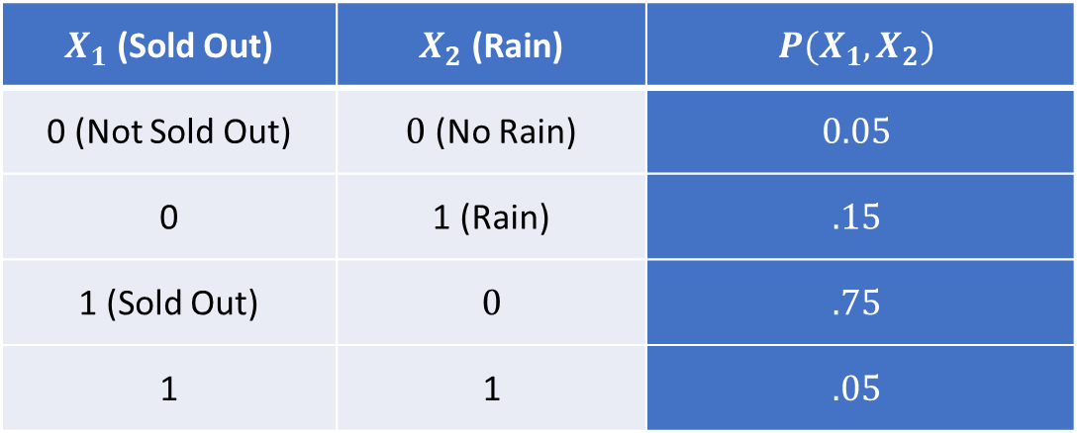
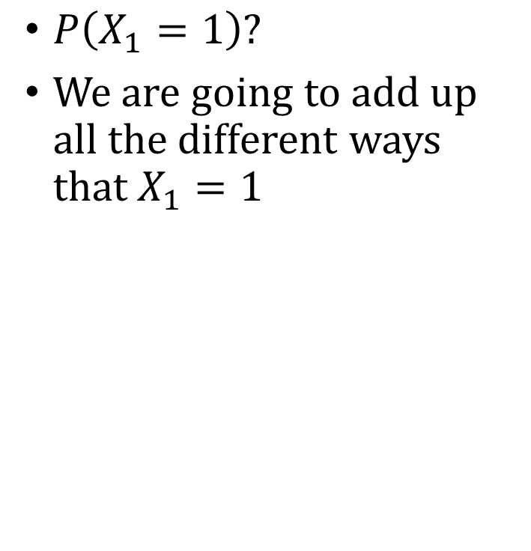
Marginal Distribution Example
$P\left(X_{1}=1\right)?$
We are going to add up all the different ways that $X_{1}=1$
$X_{1}$ (Sold Out) | $X_{2}$ (Rain) | $$P(X_{1},X_{2})$$
0 (Not Sold Out) | $0$ (No Rain) | $$0.05$$
0 | 1 (Rain) | $$.15$$
1 (Sold Out) | $$0$$ | $$.75$$
1 | 1 | $$.05$$

Slide 12

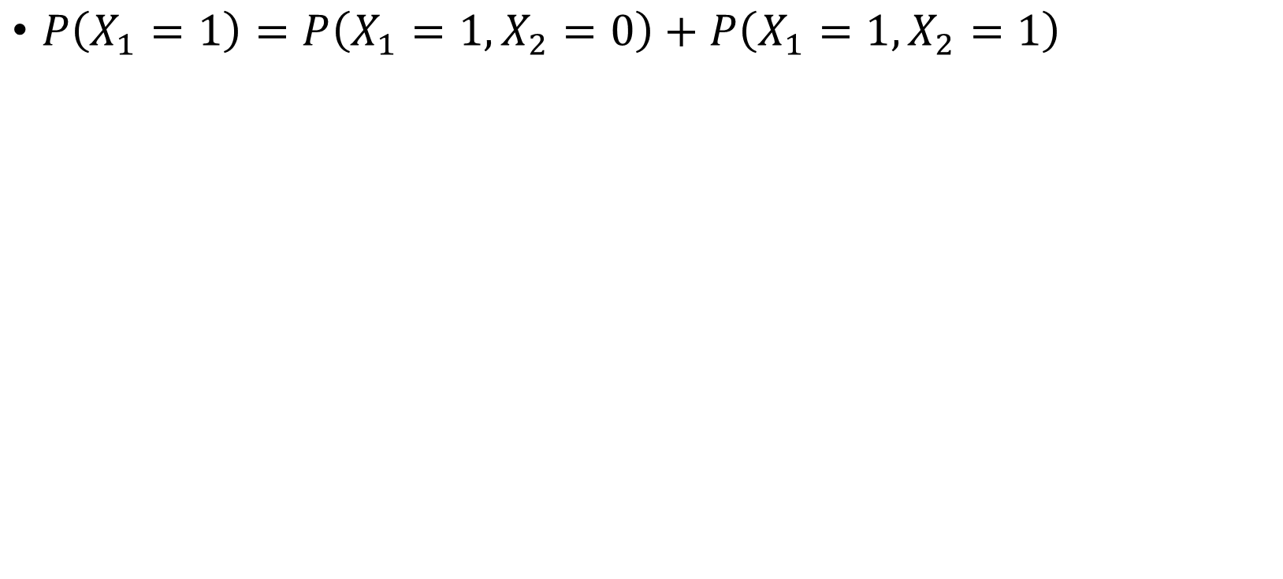
Marginal Distribution Example
$X_{1}$ (Sold Out) | $X_{2}$ (Rain) | $$P(X_{1},X_{2})$$
0 (Not Sold Out) | $0$ (No Rain) | $$0.05$$
0 | 1 (Rain) | $$.15$$
1 (Sold Out) | $$0$$ | $$.75$$
1 | 1 | $$.05$$
$P\left(X_{1}=1\right)=P\left(X_{1}=1, X_{2}=0\right)+P\left(X_{1}=1, X_{2}=1\right)$

Slide 13
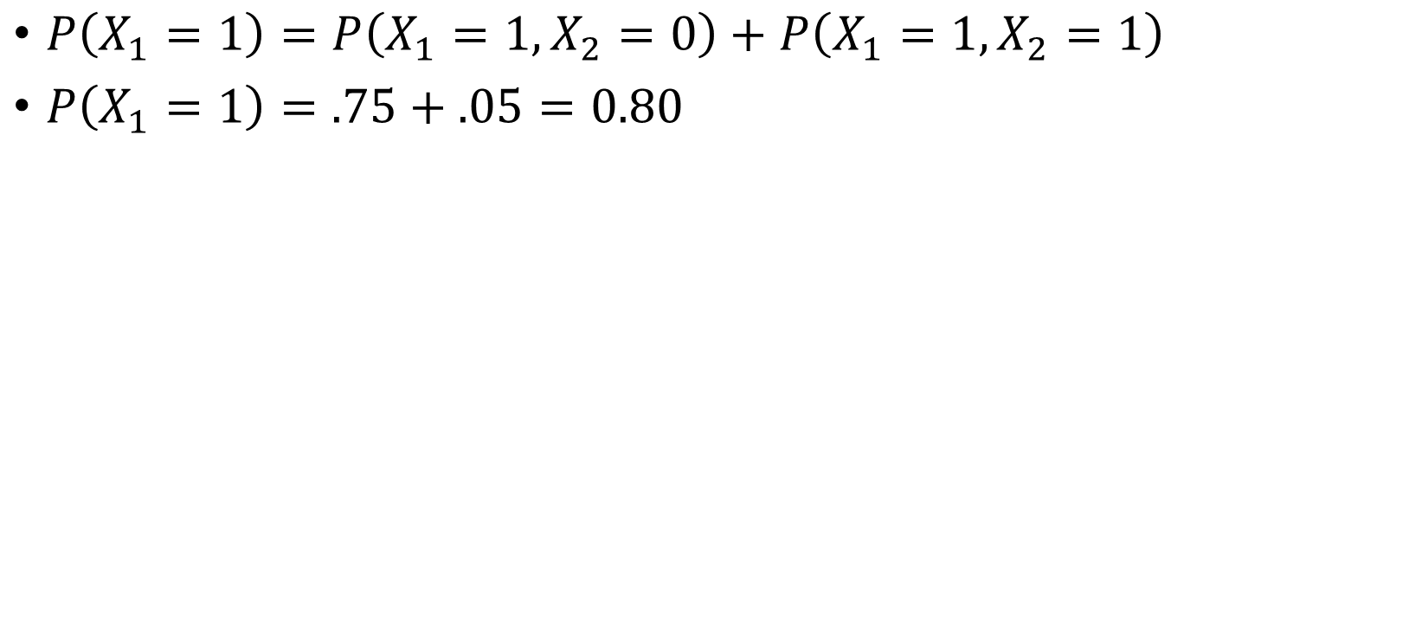
Marginal Distribution Example
$X_{1}$ (Sold Out) | $X_{2}$ (Rain) | $$P(X_{1},X_{2})$$
0 (Not Sold Out) | $0$ (No Rain) | $$0.05$$
0 | 1 (Rain) | $$.15$$
1 (Sold Out) | $$0$$ | $$.75$$
1 | 1 | $$.05$$
$P\left(X_{1}=1\right)=P\left(X_{1}=1, X_{2}=0\right)+P\left(X_{1}=1, X_{2}=1\right)$
$P\left(X_{1}=1\right)=.75+.05=0.80$

Slide 14
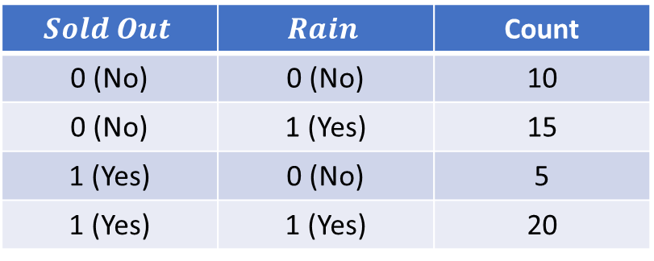
What Are We Doing When We Marginalize?
$$Sold Out$$ | $$Rain$$ | Count
0 (No) | 0 (No) | 10
0 (No) | 1 (Yes) | 15
1 (Yes) | 0 (No) | 5
1 (Yes) | 1 (Yes) | 20
In the last 50 weeks:

Slide 15
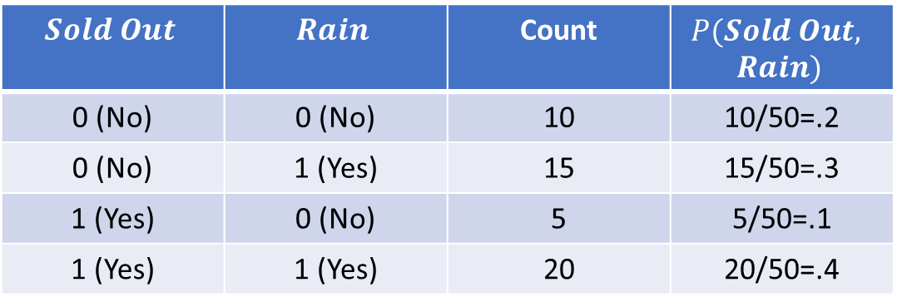
What Are We Doing When We Marginalize?
$$Sold Out$$ | $$Rain$$ | Count | $$P(Sold Out,$$ $$Rain)$$
0 (No) | 0 (No) | 10 | 10/50=.2
0 (No) | 1 (Yes) | 15 | 15/50=.3
1 (Yes) | 0 (No) | 5 | 5/50=.1
1 (Yes) | 1 (Yes) | 20 | 20/50=.4
In the last 50 weeks:

Slide 16
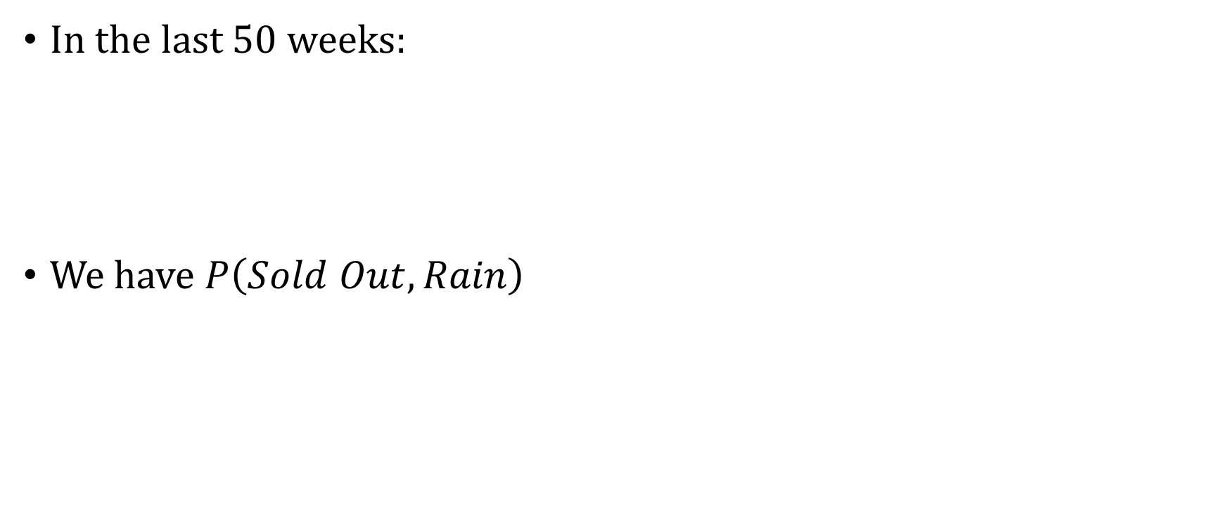
What Are We Doing When We Marginalize?
$$Sold Out$$ | $$Rain$$ | Count | $$P(Sold Out,$$ $$Rain)$$
0 (No) | 0 (No) | 10 | 10/50=.2
0 (No) | 1 (Yes) | 15 | 15/50=.3
1 (Yes) | 0 (No) | 5 | 5/50=.1
1 (Yes) | 1 (Yes) | 20 | 20/50=.4
In the last 50 weeks:
We have $P\left(Sold Out,Rain\right)$

Slide 17
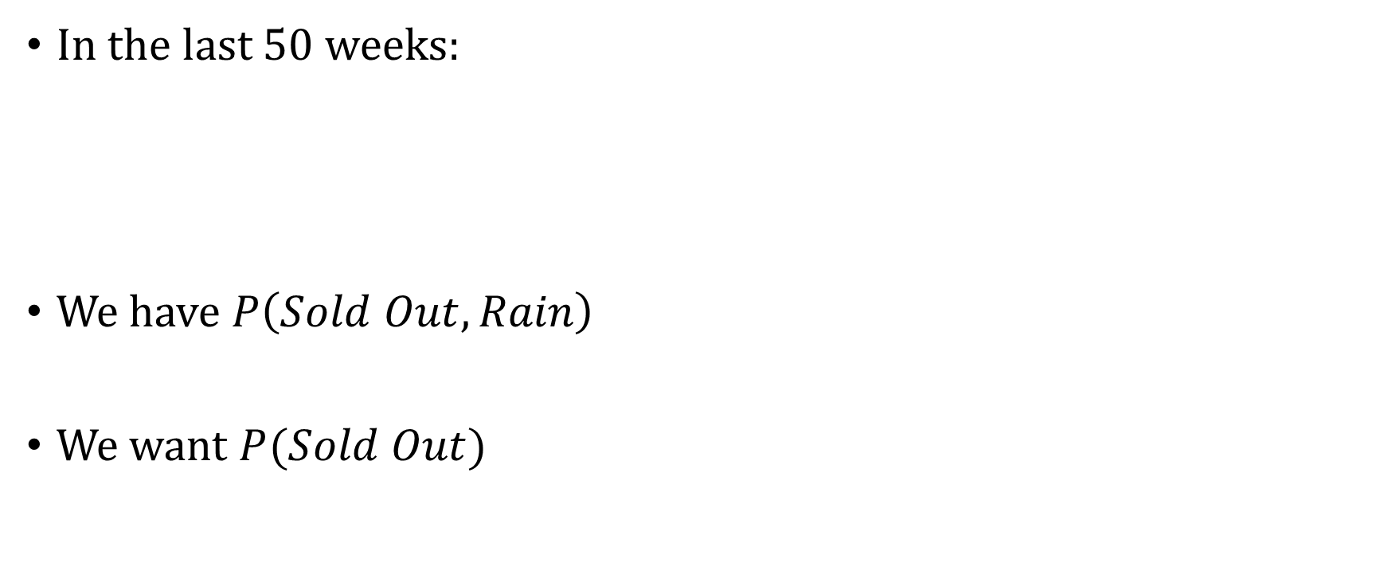
What Are We Doing When We Marginalize?
$$Sold Out$$ | $$Rain$$ | Count | $$P(Sold Out,$$ $$Rain)$$
0 (No) | 0 (No) | 10 | 10/50=.2
0 (No) | 1 (Yes) | 15 | 15/50=.3
1 (Yes) | 0 (No) | 5 | 5/50=.1
1 (Yes) | 1 (Yes) | 20 | 20/50=.4
In the last 50 weeks:
We have $P\left(Sold Out,Rain\right)$
We want $P(Sold Out)$

Slide 18
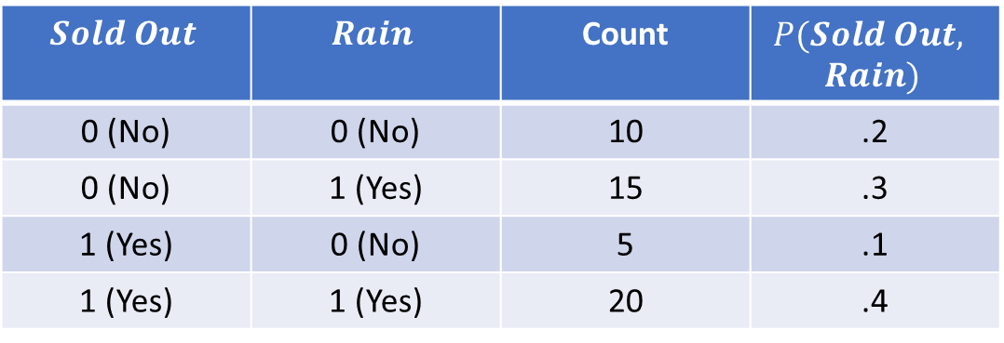
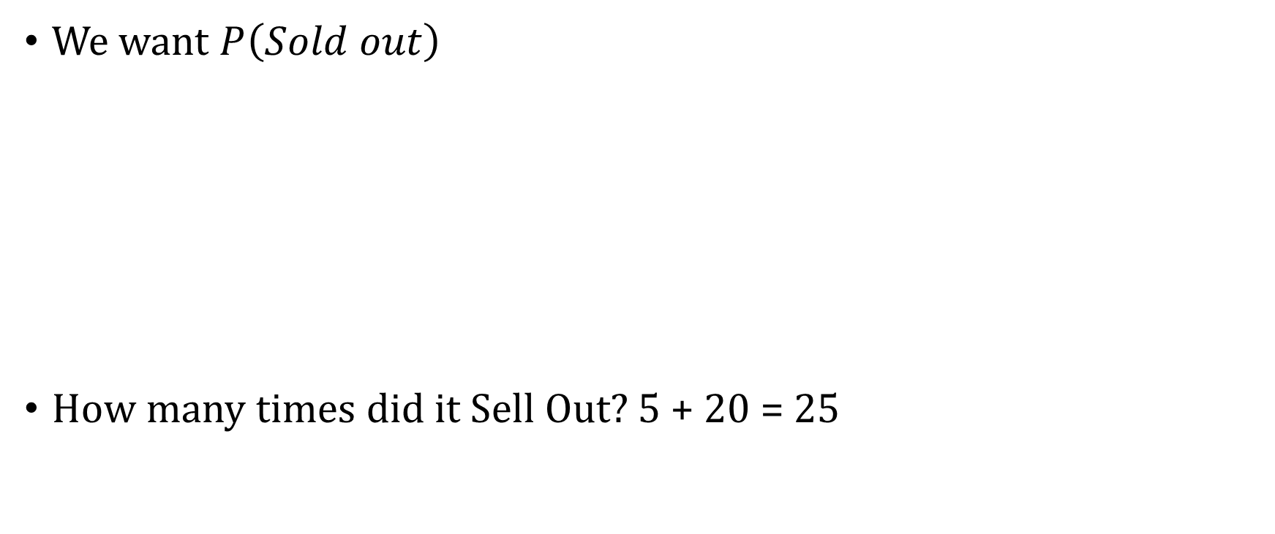
What Are We Doing When We Marginalize?
We want $P\left(Sold out\right)$
How many times did it Sell Out? 5 + 20 = 25
$$Sold Out$$ | $$Rain$$ | Count | $$P(Sold Out,$$ $$Rain)$$
0 (No) | 0 (No) | 10 | .2
0 (No) | 1 (Yes) | 15 | .3
1 (Yes) | 0 (No) | 5 | .1
1 (Yes) | 1 (Yes) | 20 | .4

Slide 19
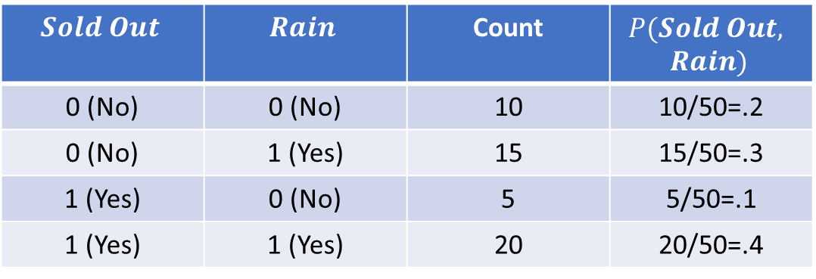
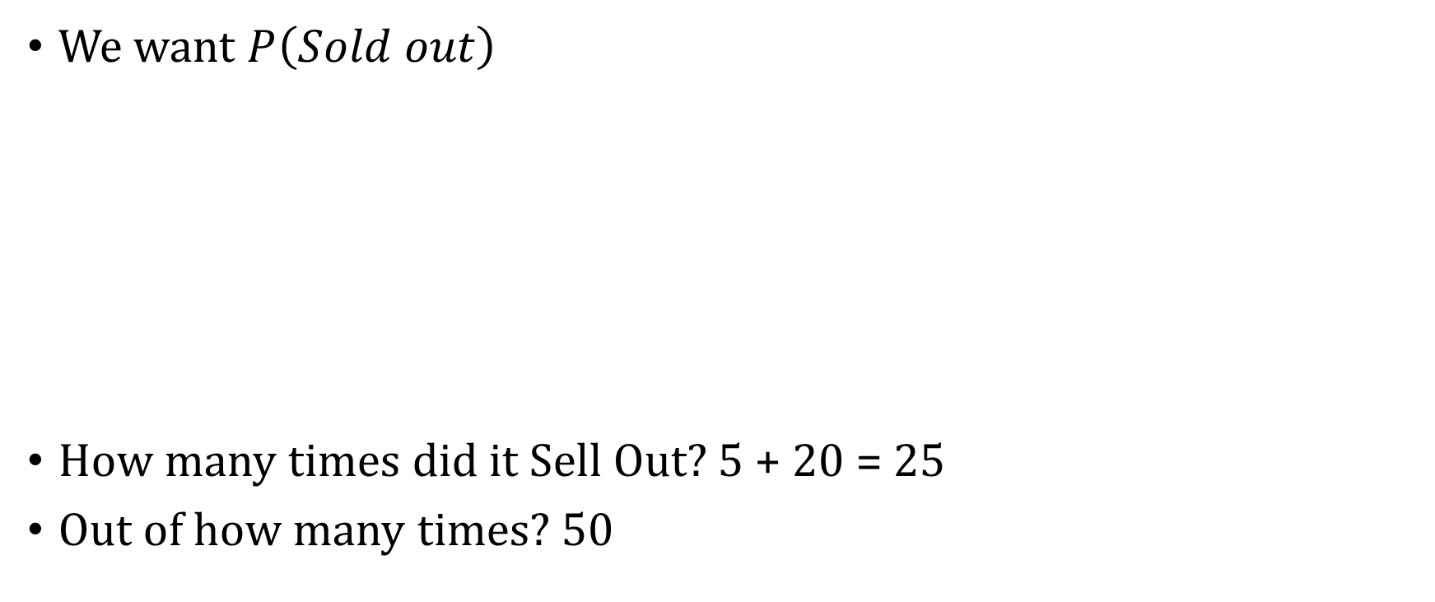
What Are We Doing When We Marginalize?
We want $P\left(Sold out\right)$
How many times did it Sell Out? 5 + 20 = 25
Out of how many times? 50
$$Sold Out$$ | $$Rain$$ | Count | $$P(Sold Out,$$ $$Rain)$$
0 (No) | 0 (No) | 10 | 10/50=.2
0 (No) | 1 (Yes) | 15 | 15/50=.3
1 (Yes) | 0 (No) | 5 | 5/50=.1
1 (Yes) | 1 (Yes) | 20 | 20/50=.4

Slide 20
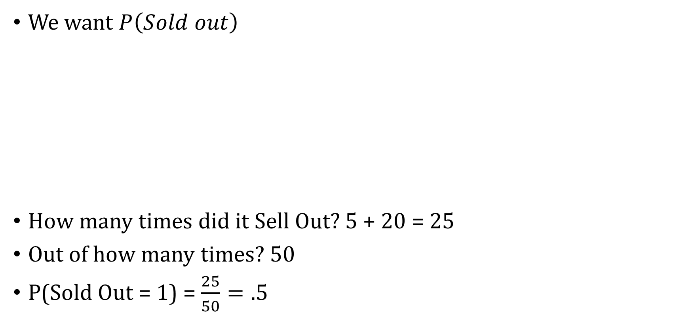
What Are We Doing When We Marginalize?
We want $P\left(Sold out\right)$
How many times did it Sell Out? 5 + 20 = 25
Out of how many times? 50
P(Sold Out = 1) = $\frac{25}{50}=.5$
$$Sold Out$$ | $$Rain$$ | Count | $$P(Sold Out,$$ $$Rain)$$
0 (No) | 0 (No) | 10 | 10/50=.2
0 (No) | 1 (Yes) | 15 | 15/50=.3
1 (Yes) | 0 (No) | 5 | 5/50=.1
1 (Yes) | 1 (Yes) | 20 | 20/50=.4

Slide 21
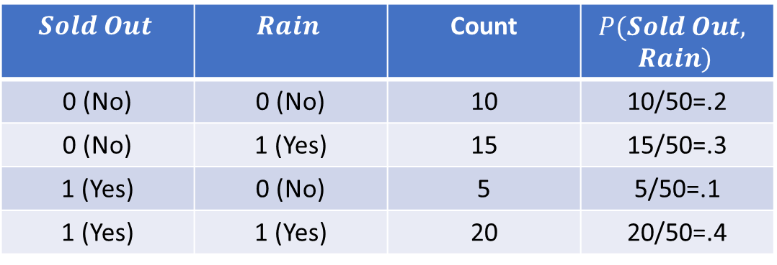
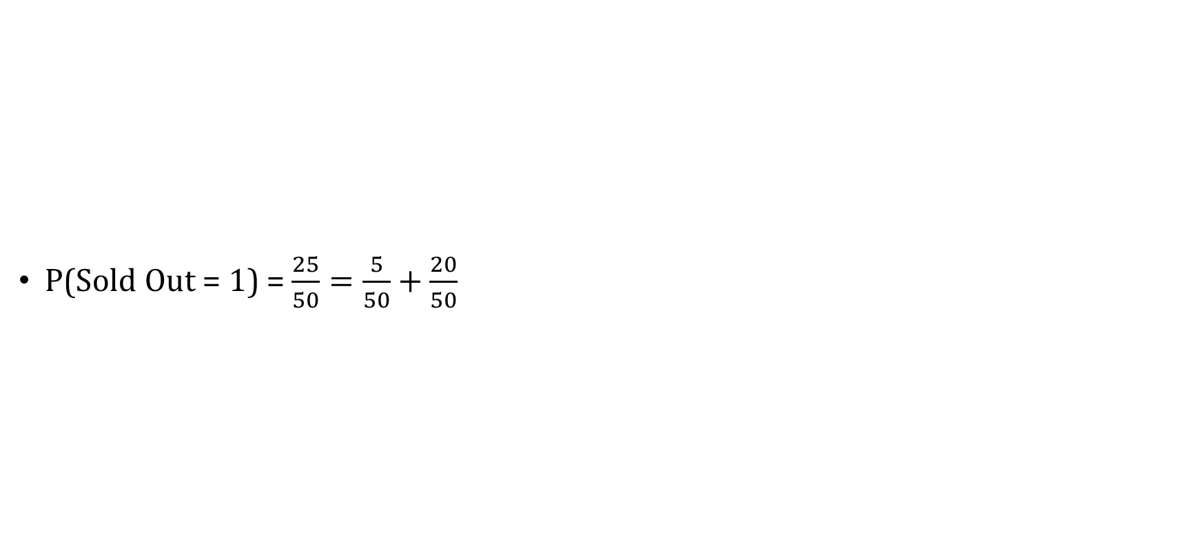
Another Way of Writing It
$$Sold Out$$ | $$Rain$$ | Count | $$P(Sold Out,$$ $$Rain)$$
0 (No) | 0 (No) | 10 | 10/50=.2
0 (No) | 1 (Yes) | 15 | 15/50=.3
1 (Yes) | 0 (No) | 5 | 5/50=.1
1 (Yes) | 1 (Yes) | 20 | 20/50=.4
P(Sold Out = 1) = $\frac{25}{50}=\frac{5}{50}+\frac{20}{50}$

Slide 22
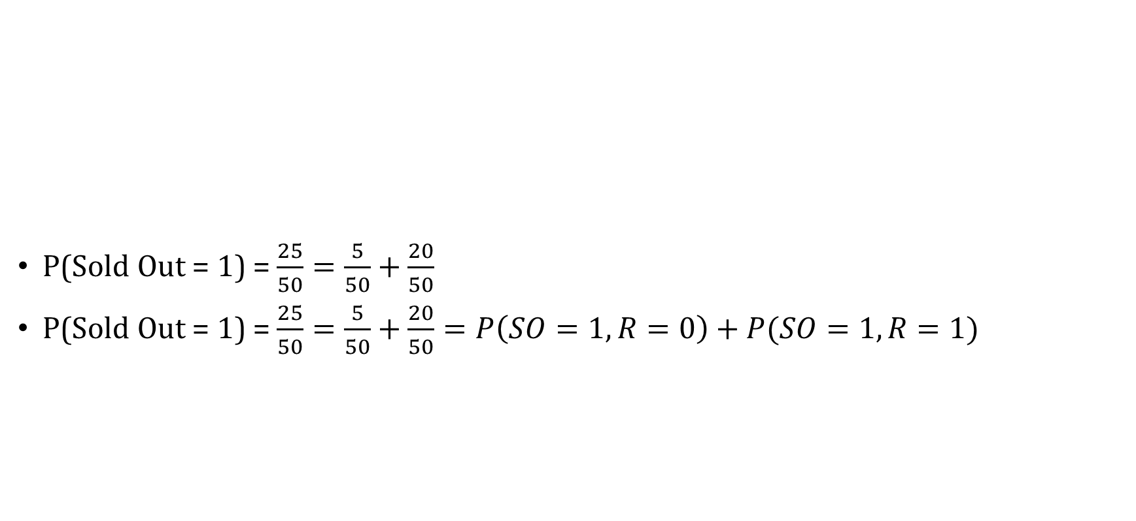
Another Way of Writing It
$$Sold Out$$ | $$Rain$$ | Count | $$P(Sold Out,$$ $$Rain)$$
0 (No) | 0 (No) | 10 | 10/50=.2
0 (No) | 1 (Yes) | 15 | 15/50=.3
1 (Yes) | 0 (No) | 5 | 5/50=.1
1 (Yes) | 1 (Yes) | 20 | 20/50=.4
P(Sold Out = 1) = $\frac{25}{50}=\frac{5}{50}+\frac{20}{50}$
P(Sold Out = 1) = $\frac{25}{50}=\frac{5}{50}+\frac{20}{50}=P\left(SO=1,R=0\right)+P(SO=1,R=1)$

Slide 23
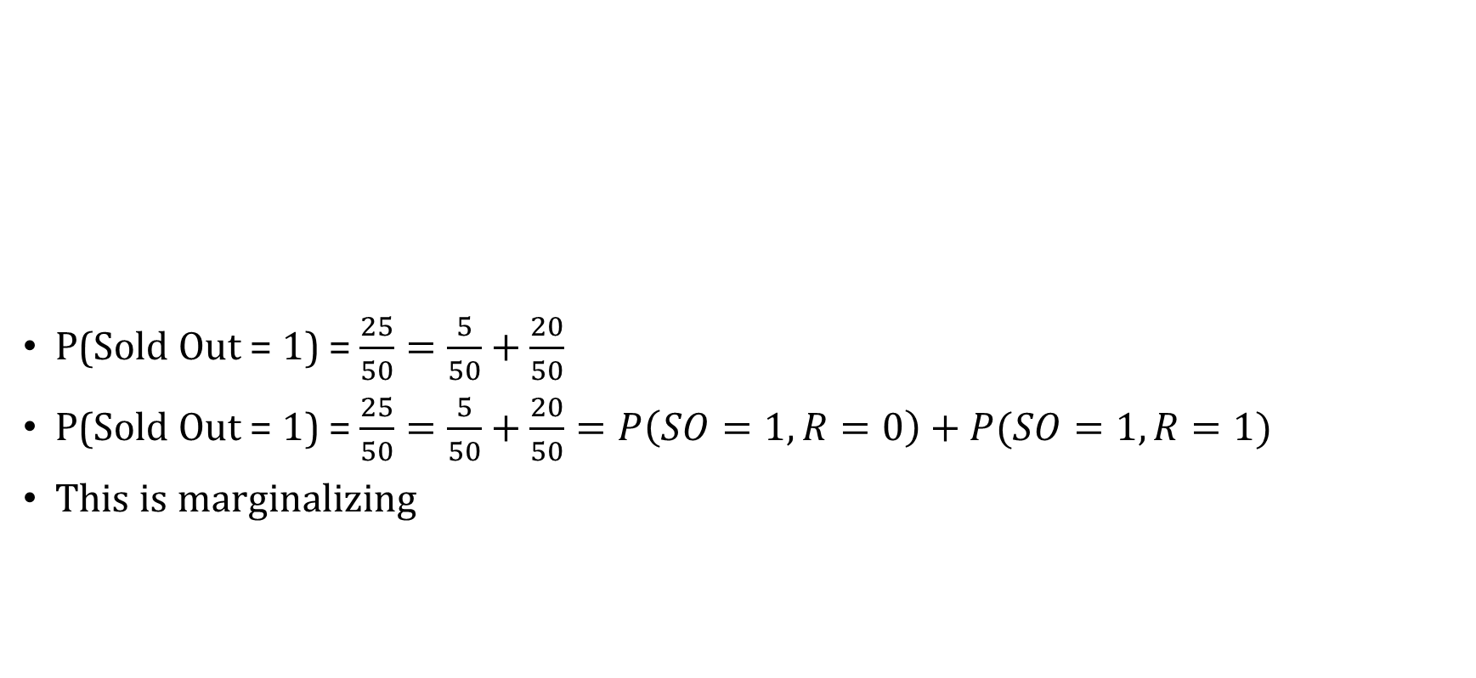
Another Way of Writing It
$$Sold Out$$ | $$Rain$$ | Count | $$P(Sold Out,$$ $$Rain)$$
0 (No) | 0 (No) | 10 | 10/50=.2
0 (No) | 1 (Yes) | 15 | 15/50=.3
1 (Yes) | 0 (No) | 5 | 5/50=.1
1 (Yes) | 1 (Yes) | 20 | 20/50=.4
P(Sold Out = 1) = $\frac{25}{50}=\frac{5}{50}+\frac{20}{50}$
P(Sold Out = 1) = $\frac{25}{50}=\frac{5}{50}+\frac{20}{50}=P\left(SO=1,R=0\right)+P(SO=1,R=1)$
This is marginalizing

